Slide 1
Catelogue
National Pharmaceutical Group Henan Medical Equipment Co.,Ltd
Anyang General International Co., Ltd.

Slide 2
*Product List
1. Non-contact Infrared Body Thermometer1. Face Mask
2. Face mask
3. Protective goggles
4. Protective uniform
5. SARS-CoV-2 Nucleic Acid Detection Kit
*Certificate
*Company Picture

Slide 3
Non-contact Infrared Body Thermometer

Slide 4
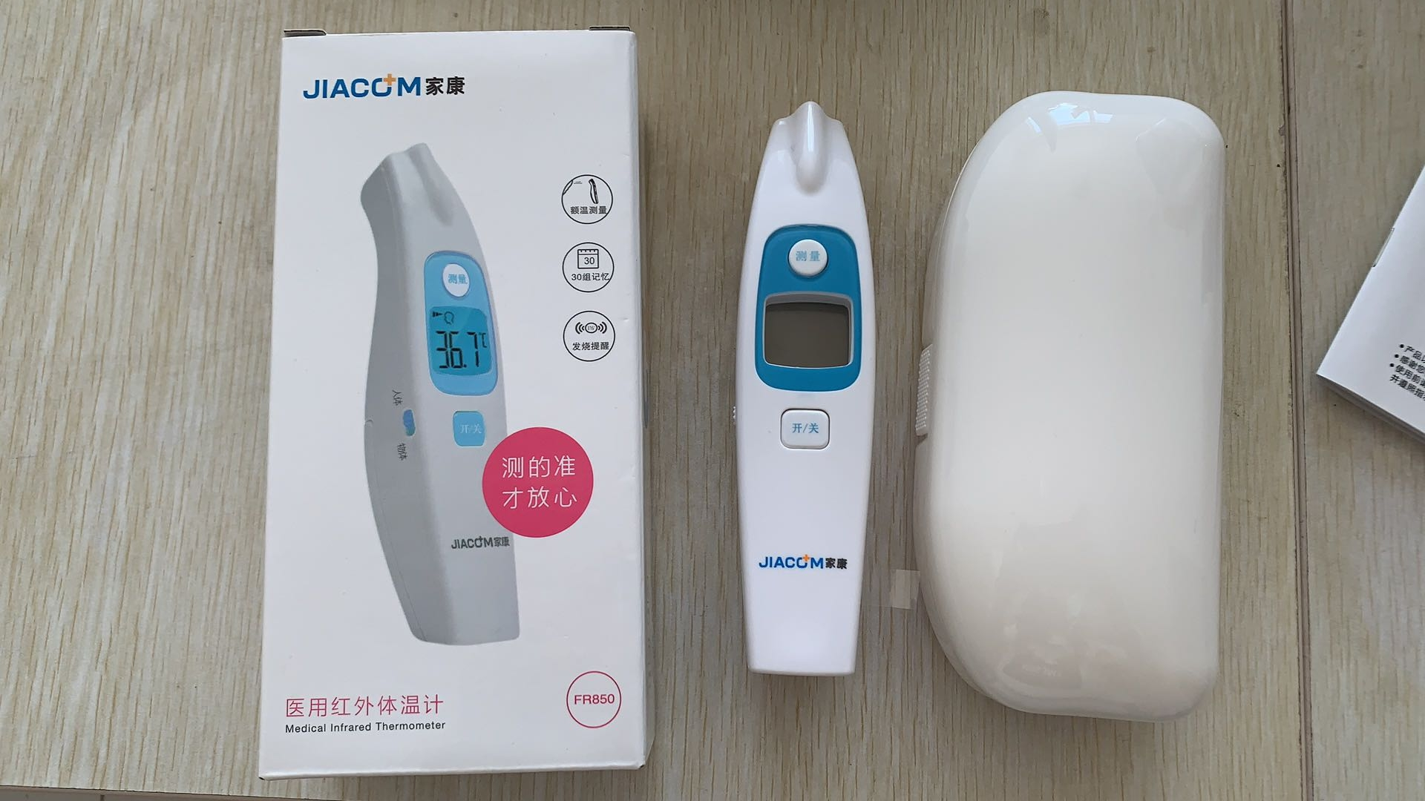
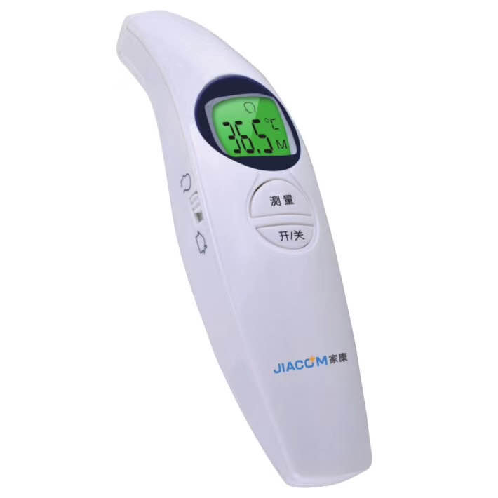
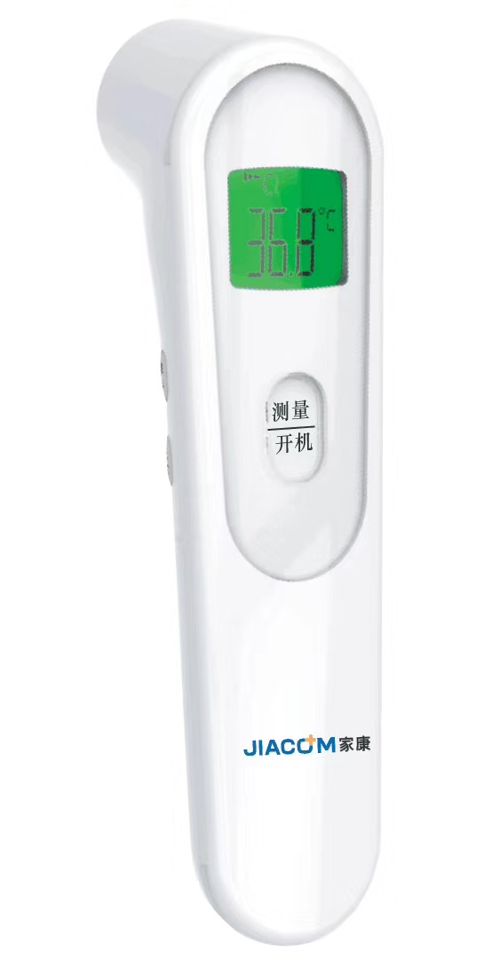
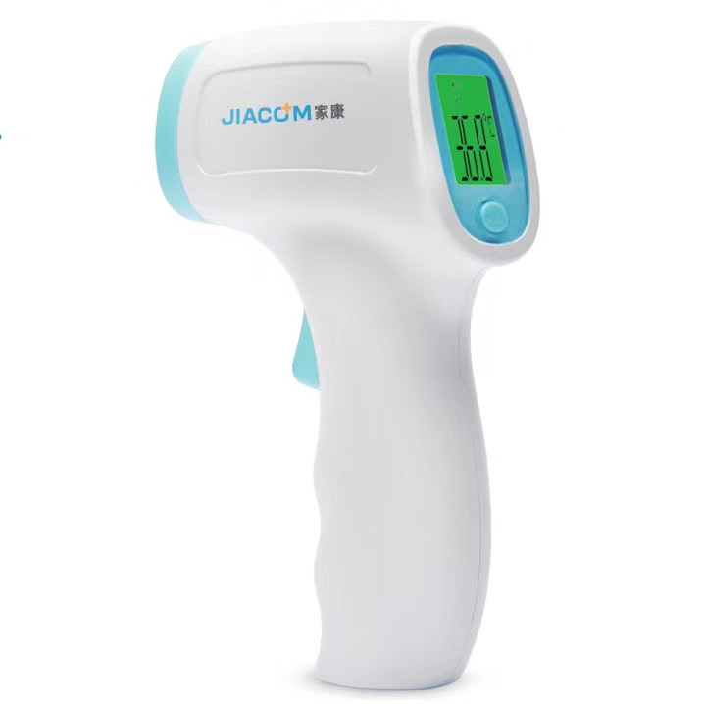
Picture Non-contact Infrared Body Thermometer

Slide 5
Face Mask

Slide 6
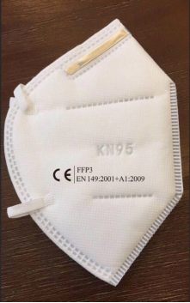
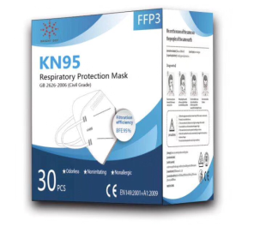
Picture Face Mask FFP3

Slide 7
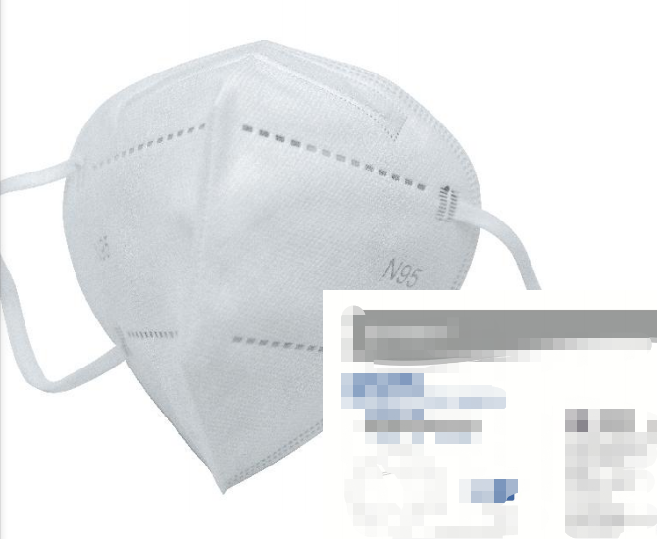
Picture Face Mask N95

Slide 8
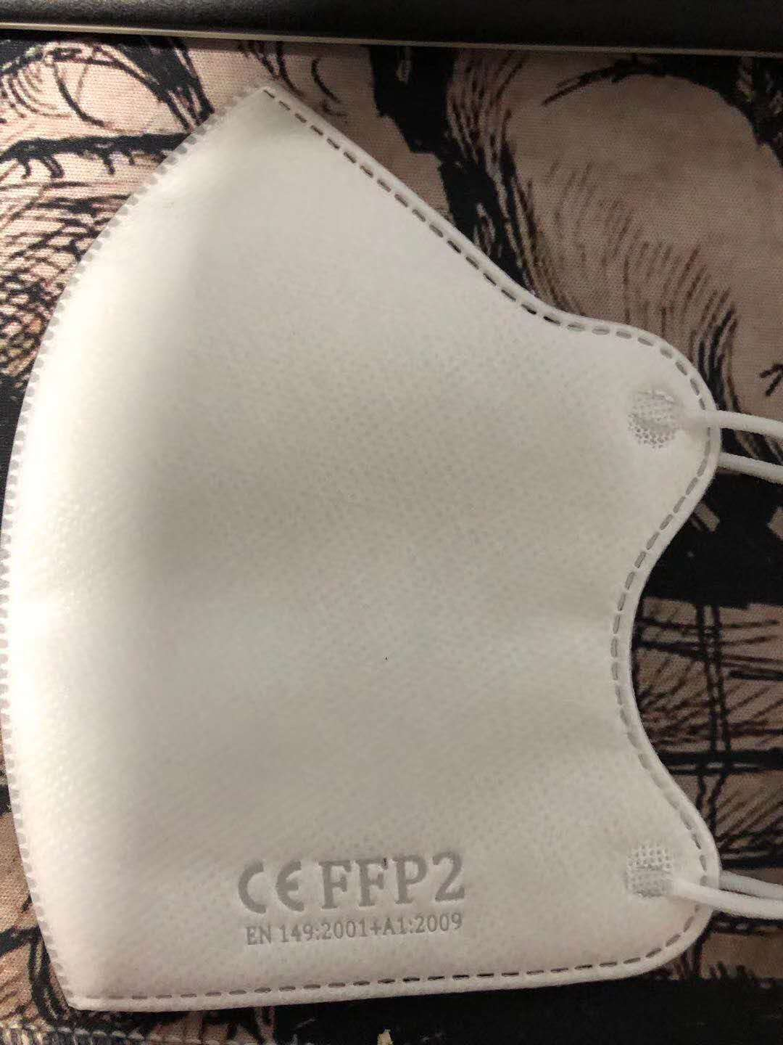
Picture Face Mask FFP2

Slide 9
Picture Disposable Surgical Mask

Slide 10
Protective Goggles

Slide 11
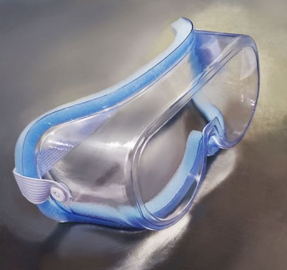
Picture Protective Goggles

Slide 12
Specification Protective Goggles

Slide 13
Protective Uniform

Slide 14
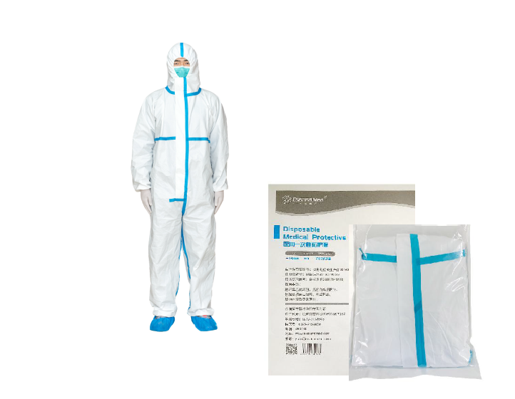
Picture Disposable Medical Protective Clothing (Sterile)
Size:160,165,170,175,180,185

Slide 15
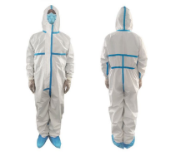
Picture Disposable Medical Protective Clothing (Non-Sterile)
Size:160,165,170,175,180,185

Slide 16
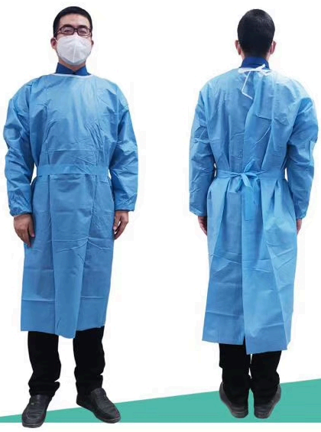
Picture Gown
Size:160,165,170,175,180,185

Slide 17
SARS-CoV-2 Nucleic Acid Detection Kit

Slide 18
Picture SARS-CoV-2 Nucleic Acid Detection Kit

Slide 19
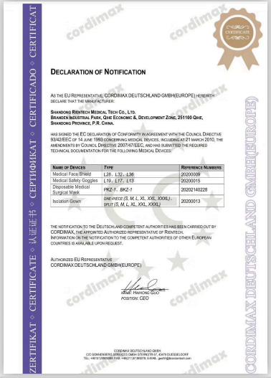
CE Identification

Slide 20
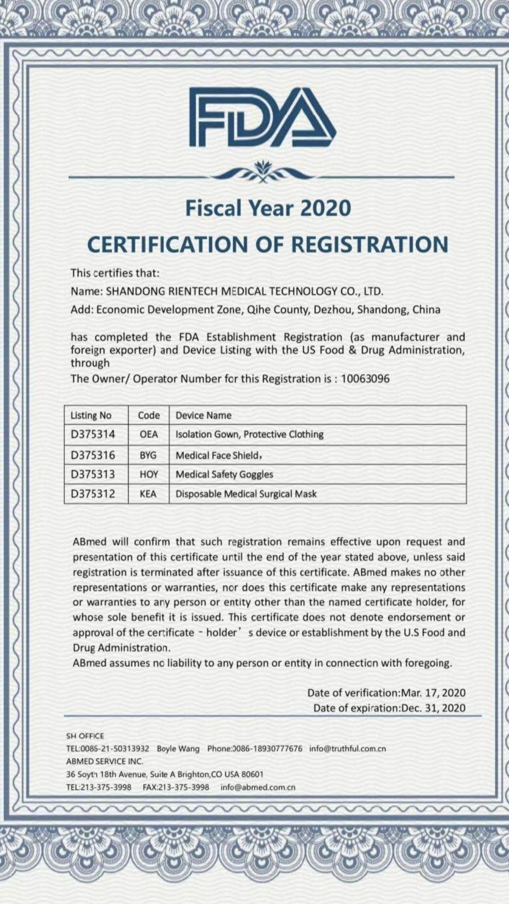
CE Identification

Slide 21
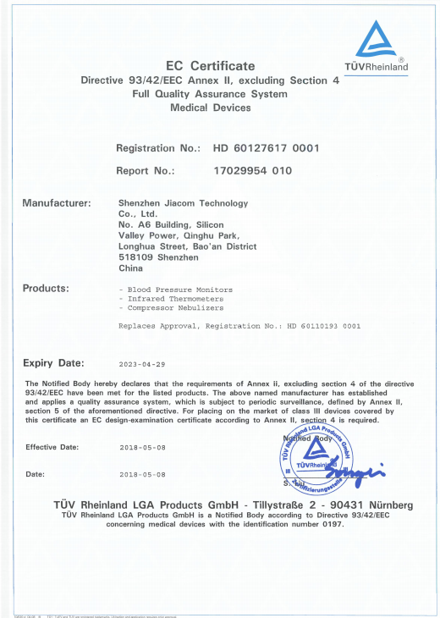
CE Certificate - Non-contact Infrared Body Thermometer

Slide 22
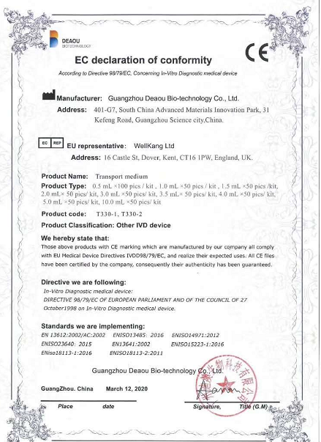
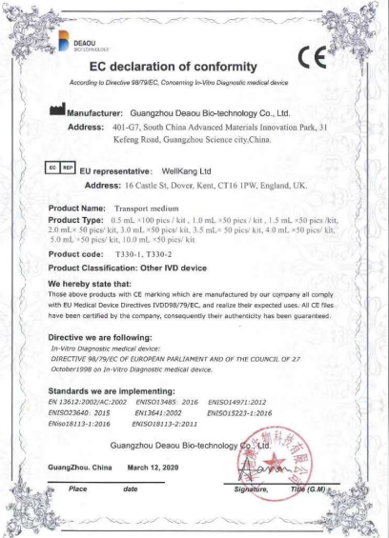
CE Identification- SARS-CoV-2 Nucleic Acid Detection Kit

Slide 23
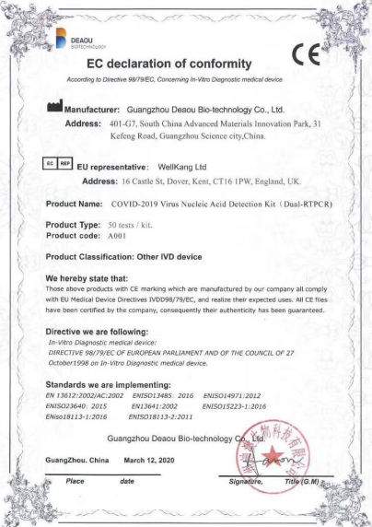
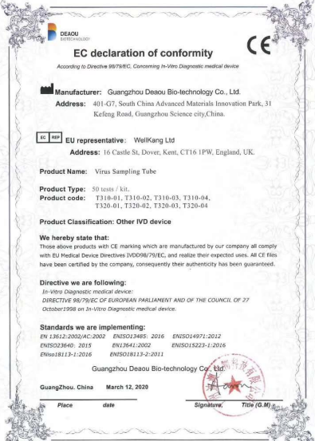
CE Identification- SARS-CoV-2 Nucleic Acid Detection Kit

Slide 24
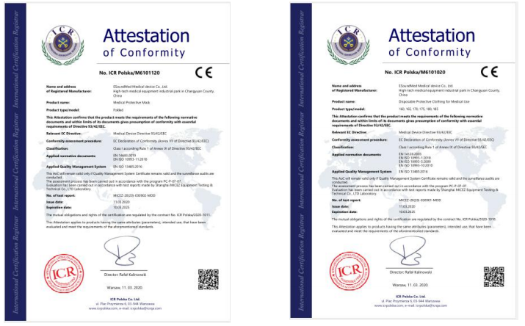
CE Identification

Slide 25
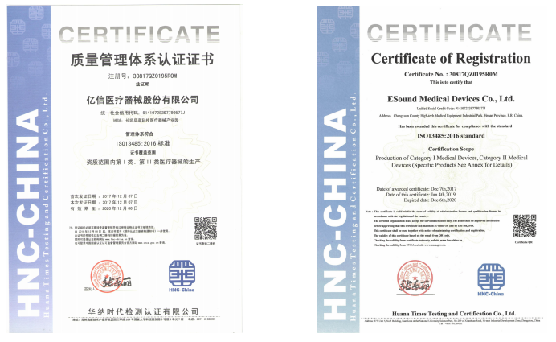
Quality System Identification

Slide 26
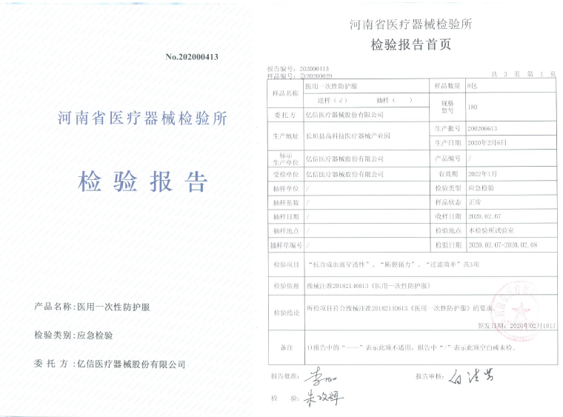
Inspection Report

Slide 27
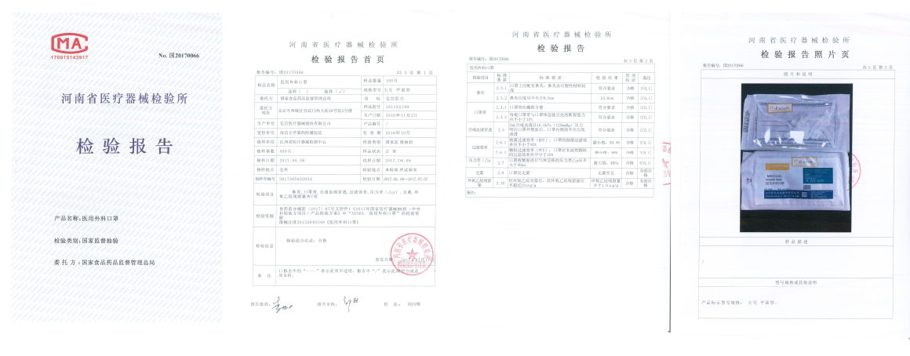
Inspection Report

Slide 28
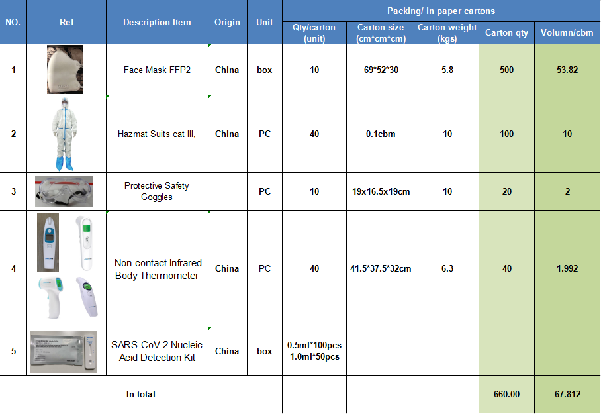
Packing Information

Slide 29
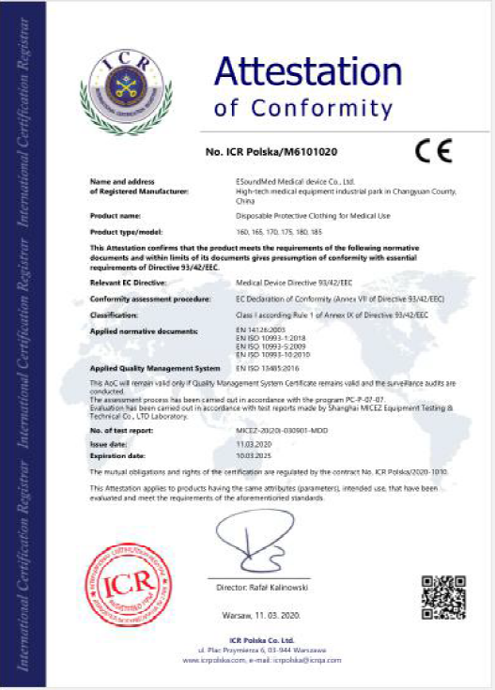
CE Certificate

Slide 30
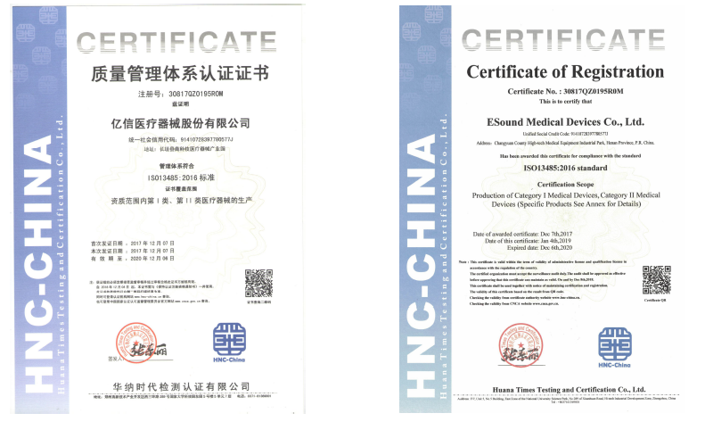
Quality system Identification

Slide 31
Company Picture

Slide 32
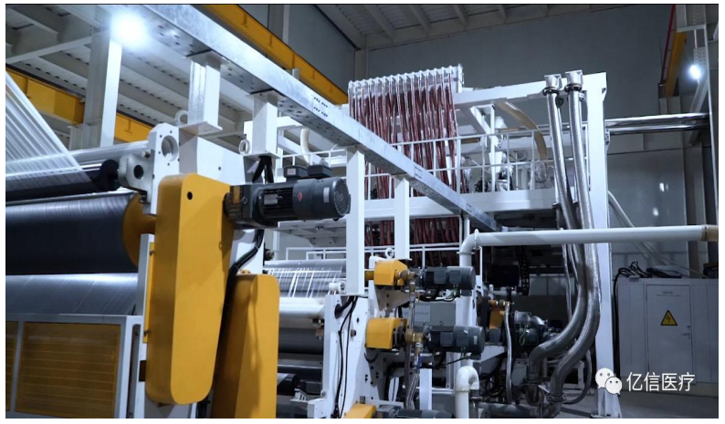
Company Picture

Slide 33
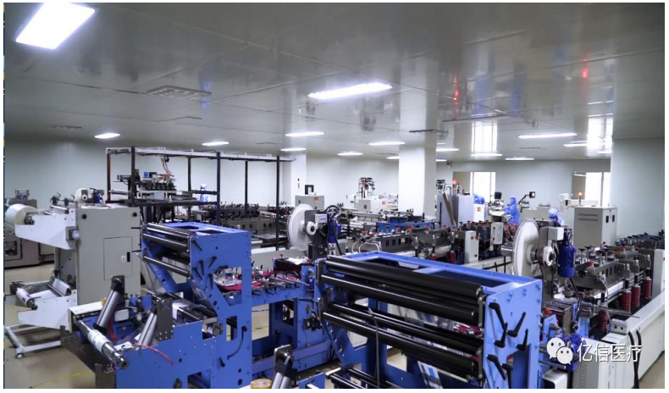
Company Picture

Slide 34
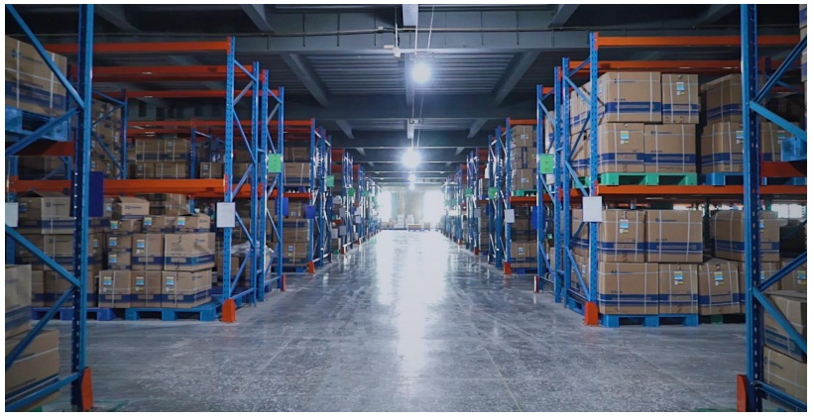
Company Picture

Slide 35
Thanks You!
National Pharmaceutical Group Henan Medical Equipment Co.,Ltd
Anyang General International Co., Ltd.

